Slide 1
Low Area ANN Architecture with Stochastic Computing and a Simplified Sigmoid Function
Huy-Hung Ho, Xuan-Thuan Nguyen, Van-Thuat Nguyen, Van-Dung Nguyen
Key Laboratory for Smart Integrated Systems (SISLAB),
VNU University of Engineering and Technology (VNU-UET)

Slide 2



Context and Motivation
Big Systems
Hardware implementation
Backpropagation algorithm
IoT Devices
Constraint
Small area
Low power
Lifecycle
Large models
High complexity
Training Time
Reduce area cost
Notes:
LeNet (1998) AlexNet (2012) OverFeat (2013) VGGNet (2014) GoogleNet (2014) ResNet (2015)

Slide 3
Outline
Context and Motivation
Proposed design
Evaluation
Conclusion

Slide 4

Proposed Design
Reference model of LSI Contest
Fixed size 2-3-2 architecture
Sigmoid function LUT: high area cost
Complex operators
Weighted input
Additions
Multiplications
Sigmoid function
$$\frac{1}{1+e^{−x}}$$
Proposed design
Parameterized ANN architecture (Backpropagation)
Optimized Sigmoid Function
Lower LUT memory
Forward ANN use Stochastic Computing
Replacing Addition, Multiplication by Logic gate
Low area cost
High frequency
Notes:
High-cost area

Slide 5
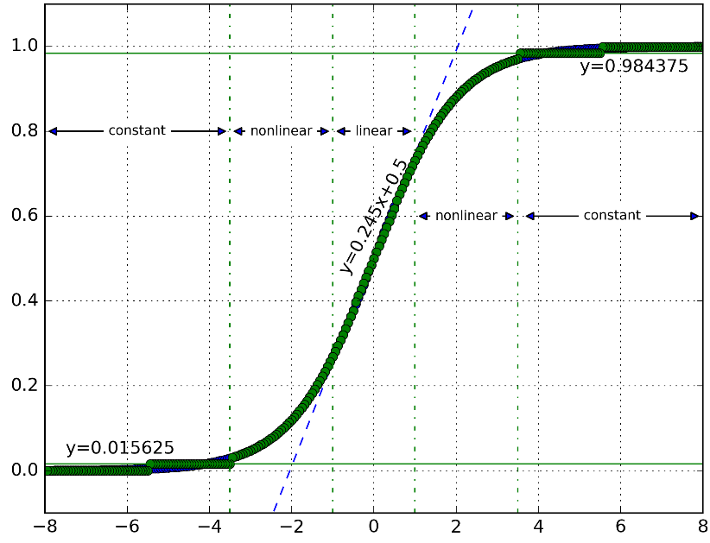
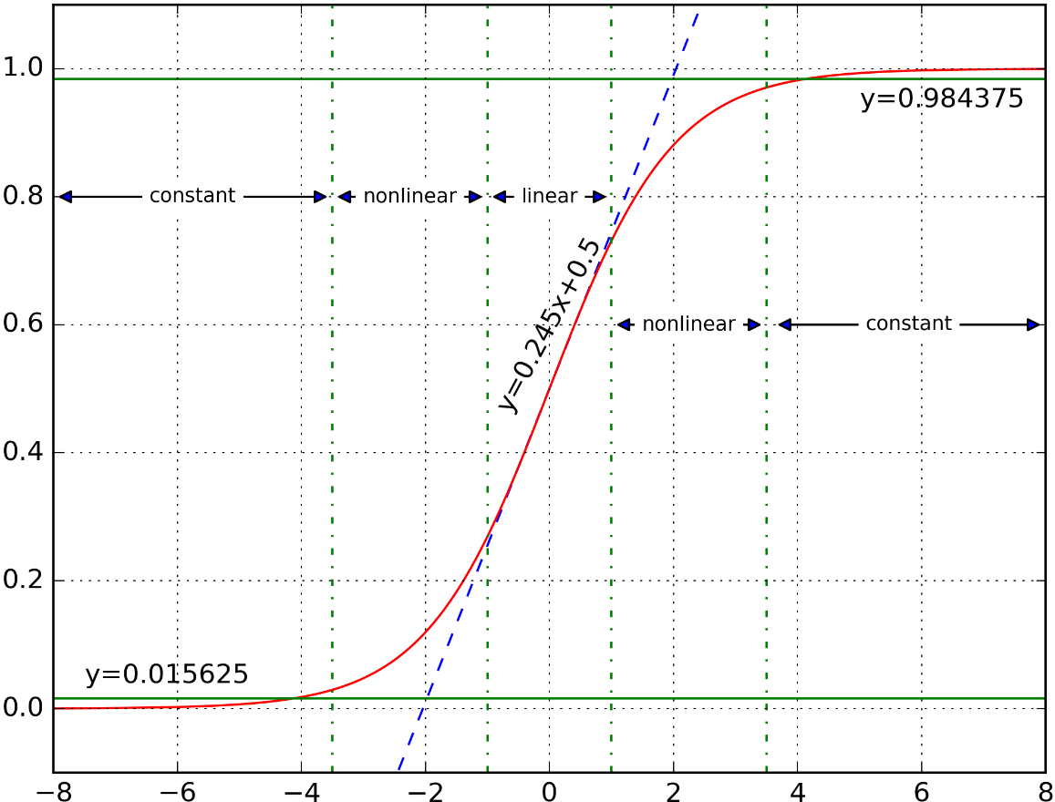
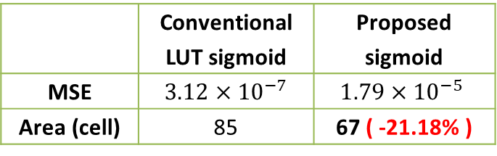
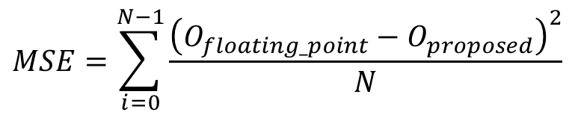
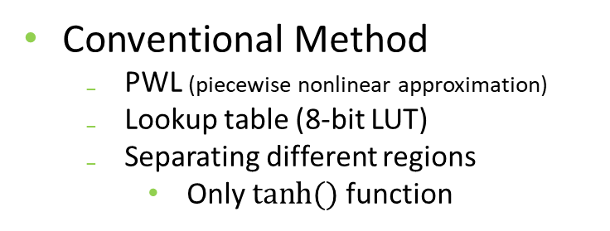
Optimized Sigmoid function
Conventional Method
PWL (piecewise nonlinear approximation)
Lookup table (8-bit LUT)
Separating different regions
Only $tanh⁡()$ function
Proposed Sigmoid Function
3 different regions
Constant region
Linear region
Non-linear region
5-bit LUT & 3-bit LUT
Evaluation
 | Conventional LUT sigmoid | Proposed sigmoid
MSE | $3.12×{10}^{−7}$ | $$1.79×{10}^{−5}$$
Area (cell) | 85 | 67 ( -21.18% )
$$MSE=\sum_{i=0}^{N−1}{\frac{{\left(O_{floating_point}−O_{proposed}\right)}^{2}}{N}}$$
MSE: Mean square error

Slide 6

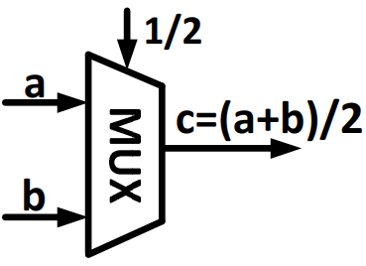
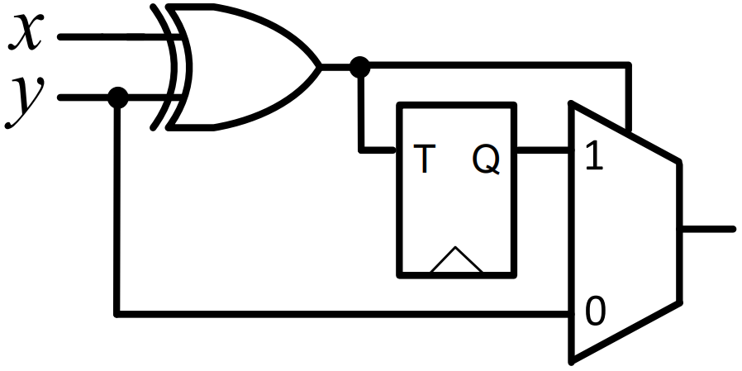




Forward ANN use Stochastic Computing
Stochastic computing (SC)
Process data in the form of digitized probabilities
Stochastic Number Generation (SNG)
SC Multiplication
SC Scale Addition
Sigmoid function
$$\frac{1}{1+e^{−x}}$$
SNG
Weighted input
Additions
Multiplications
$$\frac{2}{8}$$
>
1,0,0,1,0,0,0,0
LFSR
$$Bit ‘1’ probability = 2/8$$
Stochastic Computing domain
Logic gate,
MUX
$z$=($x$+$y$)/2
[Lee2017eeh]
LFSR: Linear Feedback Shift Register

Slide 7
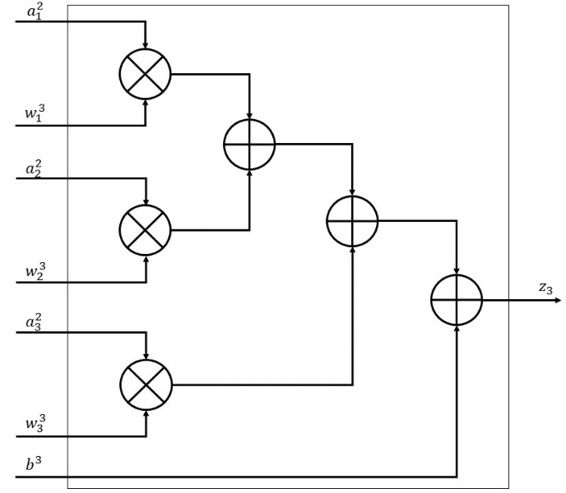
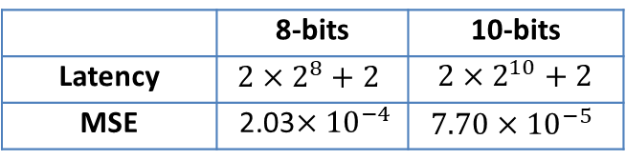
Forward ANN use Stochastic Computing (cont.)
Forward ANN Simulation with SC length
 | 8-bits | 10-bits
Latency | $$2×2^{8}+2$$ | ${2×2}^{10}+2$
MSE | 2.03$×{10}^{−4}$ | $$7.70×{10}^{−5}$$
MSE: Mean square error
Conventional architecture
Proposed SC architecture

Slide 8
Outline
Context and Motivation
Proposed design
Evaluation
Conclusion

Slide 9
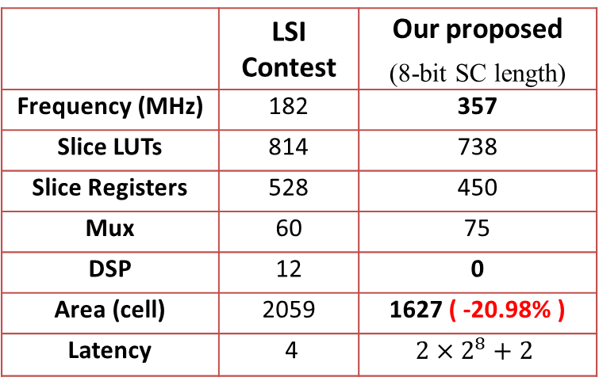
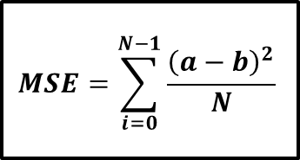
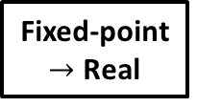
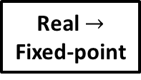
Evaluation
Environment
VHDL language
Vivado Xilinx Tool
Xilinx FPGA VC707 28nm
2-3-2 Forward Model
Low area cost
High frequency
Do not use DSP
High latency
Verification Implementation
2-3-2 forward ANN architecture evaluation
 | LSI Contest | Our proposed (8-bit SC length)
Frequency (MHz) | 182 | 357
Slice LUTs | 814 | 738
Slice Registers | 528 | 450
Mux | 60 | 75
DSP | 12 | 0
Area (cell) | 2059 | 1627 ( -20.98% )
Latency | 4 | $$2×2^{8}+2$$
Input
(real value)
Real $→$ Fixed-point
Proposed Design
Fixed-point $→$ Real
$$MSE=\sum_{i=0}^{N−1}{\frac{{\left(a−b\right)}^{2}}{N}}$$
MSE
Math Equation
MSE: Mean square error

Slide 10
Conclusion
Contest Requirement
2-3-2 ANN architecture with 5 sets of inputs
Proposed Design
Parameterized 2-3-2 ANN architecture
Simplified Sigmoid architecture
21.18% area cost
Forward architecture use Stochastic computing
20.98% area cost (compared to Contest reference model)
Limitation: High latency
Future work
Apply Stochastic Computing for Backward module
Reduce more area cost

Slide 11
Thank you for your attention

Slide 12
Backup slide

Slide 13
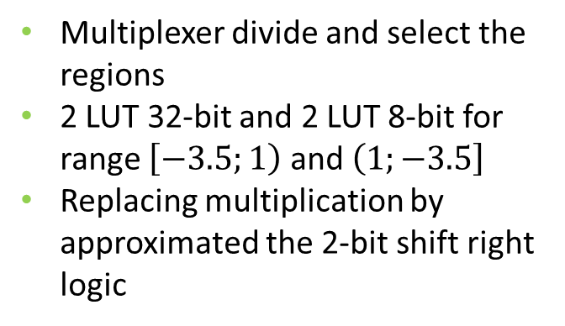
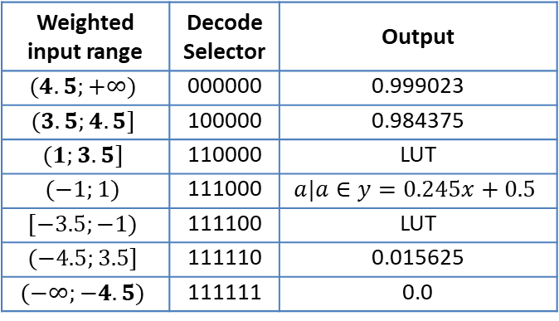
Simplified Sigmoid Function Architecture
Multiplexer divide and select the regions
2 LUT 32-bit and 2 LUT 8-bit for range $\left[−3.5;1\right)$ and $\left(1;−3.5\right]$
Replacing multiplication by approximated the 2-bit shift right logic
Weighted input range | Decode Selector | Output
$$(4.5;+∞)$$ | 000000 | 0.999023
$$(3.5;4.5]$$ | 100000 | 0.984375
$$(1;3.5]$$ | 110000 | LUT
$$(−1;1)$$ | 111000 | $$a|a∈y=0.245x+0.5$$
$$[−3.5;−1)$$ | 111100 | LUT
$$(−4.5;3.5]$$ | 111110 | 0.015625
$$(−∞;−4.5)$$ | 111111 | 0.0

Slide 14
2-3-2 Forward architecture use Stochastic Computing
Our proposed architecture using SC
Reference architecture
of LSI Contest

